Slide 1
District Deputy
District Forms
Watch Forms overview for Grand Knights if you need an overview of council forms. Your councils will need help with forms so I’d recommend you familiarize yourself with this so you can help them.

Slide 2
Agenda
This symbol will help provide tips and guidance..
DD Supreme Forms
Accessing Supreme Forms
Review of Supreme Forms
Michigan Forms
Accessing Michigan Forms
Review of Michigan Forms
Council Forms (Summary)
Go in document section
Go to WEB Link
Return to home page

Slide 3
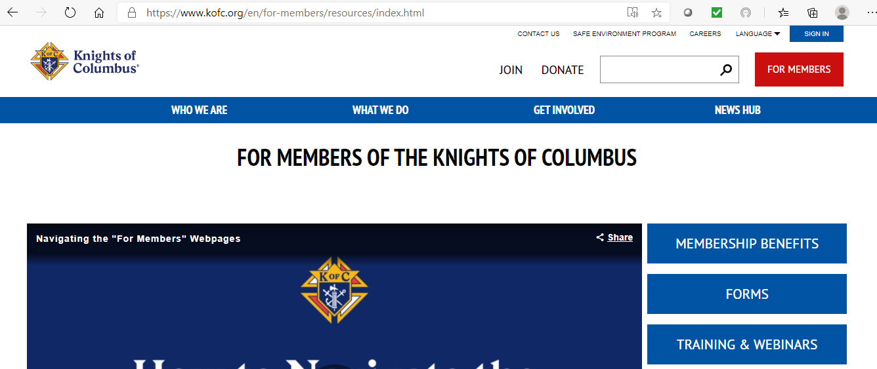
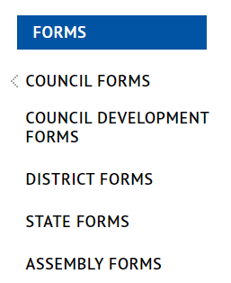
1.1 Accessing Supreme Forms
Go to Supreme Website
Click on
Click on
Click on

Slide 4
1.2 Review of Supreme Forms
Form # | District Form Name | PDF | Preferred Method | Due Date
#944 | District Deputy Semiannual Report | PDF | N/A | 6/30 & 12/31
#450 | District Deputy Degree Exemplification Report | PDF | Online | As needed
#267 | District Deputy Expense Form | PDF | Excel | Quarterly
#133 | Notice of Intent | PDF | N/A | As needed
#136 | Notice of Institution of a Council | PDF | N/A | As needed
#137 | Application for Council Charter | PDF | N/A | As needed
Expense report forms are also required but are covered in a separate presentation.

Slide 5
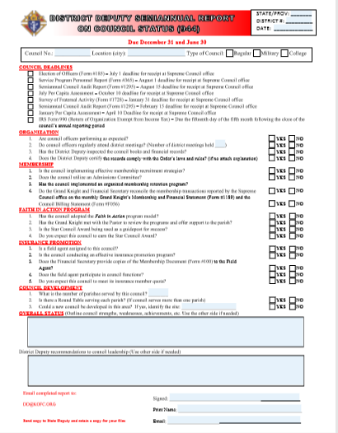
Form #944 DD SemiAnnual Report
Fill this out twice each year (Due 6/30 & 12/31)
Do one for each council in your District
Obtain previous reports from your predecessor when you become District Deputy
Send this report to…
Supreme – DD@kofc.org
State – forms@mikofc.org
State – State Deputy Regional Representative

Slide 6
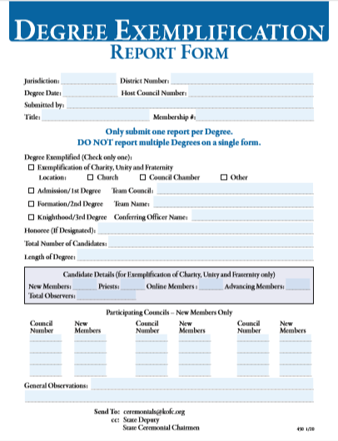
Form #450 - Degree Exemplification Report
PDF Form Online Form
Submit this form within 24 hours AFTER a Charity, Unity & Fraternity exemplification.
Please include:
Check all boxes (1st, 2nd & 3rd degree)
Submit it to…
Supreme - ceremonials@kofc.org
State – Diocesan Membership Director
State – forms@mikofc.org

Slide 7
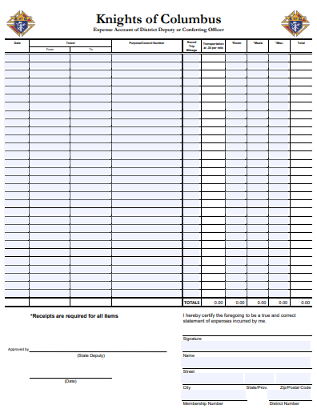
Form #267 – DD Expense Report Form
PDF Form Excel Form
Items allowable on Supreme Expense Report include:
Visiting “your” councils (Mtgs, events & degrees)
Summer & Winter “State” meetings
Allowable expenses include:
Mileage, Parking & Tolls
Hotels (for Summer/Winter Meetings)
Meals (Only for you. Check with SDRR on details)
Instructions (see page 2 of PDF, sheet 2 of Excel)
Submit it: (fill it out, print it, sign it, scan it & email if to the State Deputy w.winkle@mikofc.org)

Slide 8
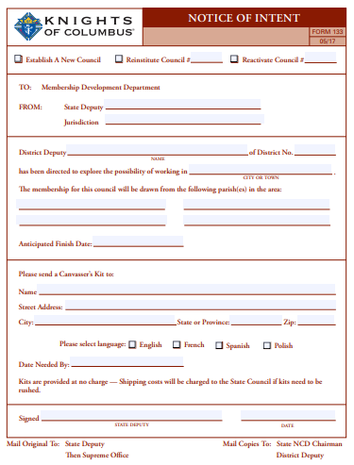
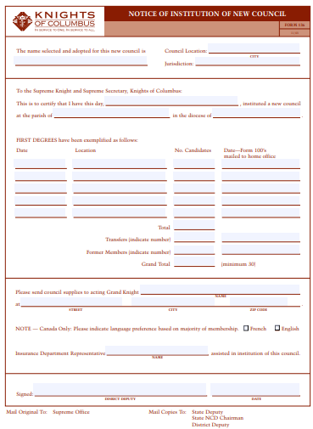
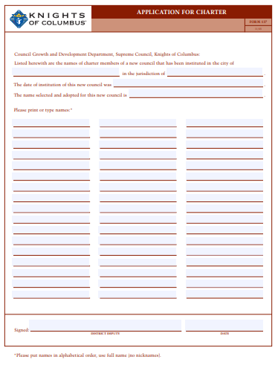
New Council Development Forms 133, 136 & 137

Slide 9
2.1 Accessing Michigan Forms
Go to Michigan Website (www.mikofc.org
Click on
Click on

Slide 10
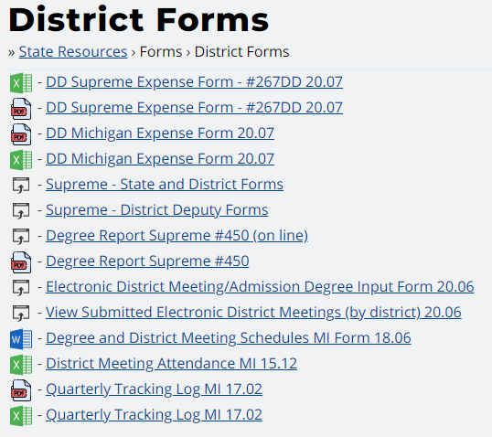
Michigan Forms
Michigan forms are bolded
Enhanced version of the Supreme form (does the math) -----→
Same form as found on Supreme website ----------------------→
Michigan Expense report forms (PDF & Excel) -----------→
Link to Supreme forms of District Deputies (1 of 3) ----------→
Link to Supreme forms of District Deputies (2 of 3) ----------→
Link to Supreme form #450 (PDF & Online) ------------------→
Link to District Meeting / Exemplification Form ----------→
Link to view District Meeting/Exemplification Form -----→
Word version of District Mtg/Exemplification Form -----→
Form used to document attendees at your District Mtg --→
Quarterly tracking log (PDF & Excel) -----------------------→
Supreme forms are also listed here for a 1-stop shop experience

Slide 11
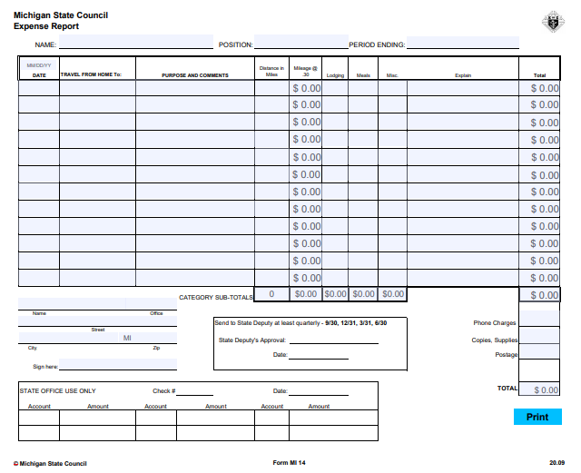
Michigan Expense Report Form
PDF Form Excel Form
Items allowable on Michigan Expense Report include:
State & Diocesan meetings (Includes convention)
Travel outside your District (pre-approval by SDRR required)
Allowable expenses include:
Mileage, Parking & Tolls
Hotels (for Summer/Winter Meetings)
Meals (Only for you. Check with SDRR on details)
Instructions (see page 2 of PDF, sheet 2 of Excel)
Submit it: (fill it out, print it, sign it, scan it & email it to the State Deputy w.winkle@mikofc.org)

Slide 12
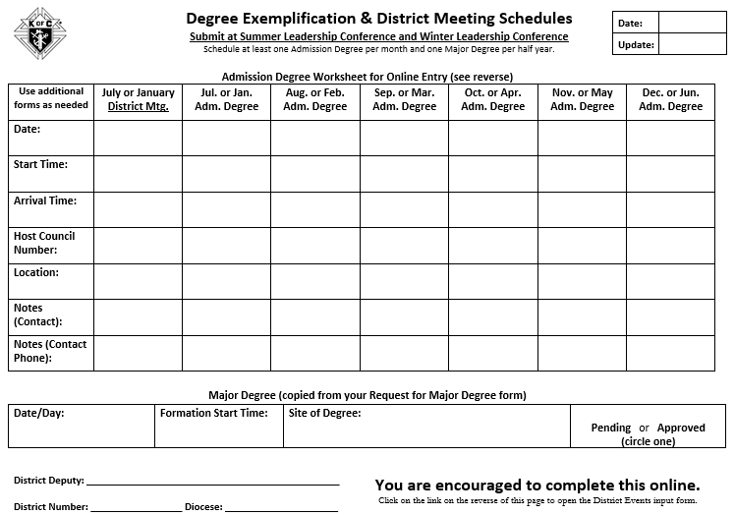
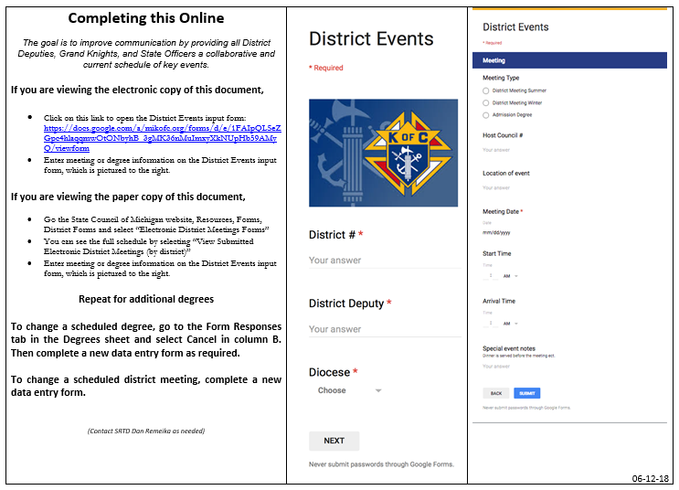
District Meeting / Exemplification Form
Due prior to Summer / Winter Meetings
Watch this Instructional YouTube video to see how to fill it out
Word Version Online Version (preferred)

Slide 13
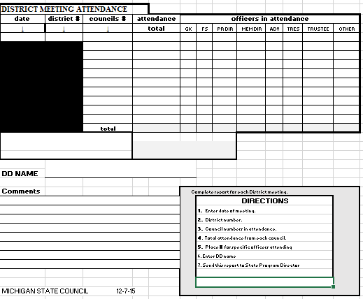
District Meeting Attendance
Excel form
Submit this form within 24 hours AFTER each District Meeting you hold (Summer & Winter)
Submit it to…
State – State Deputy Regional Representative
State – forms@mikofc.org

Slide 14
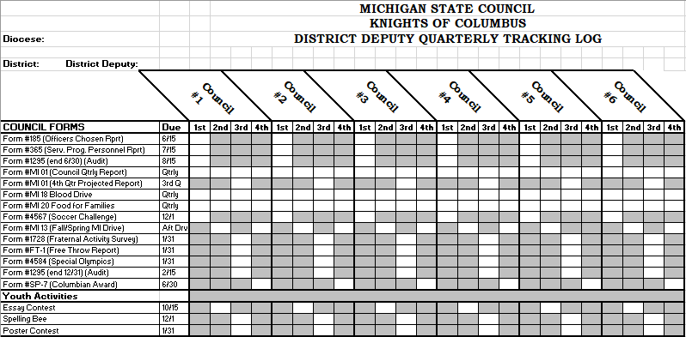
Quarterly Tracking Log (PDF and Excel versions)

Slide 15
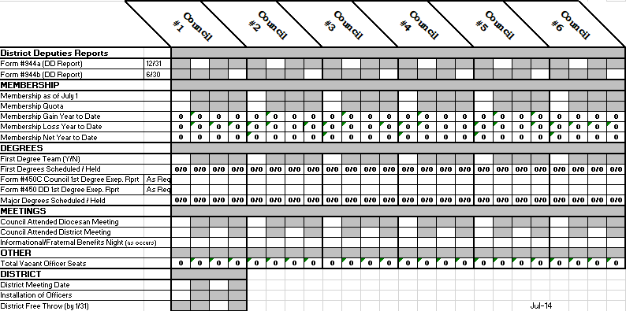
Quarterly Tracking Log (cont.)

Slide 16
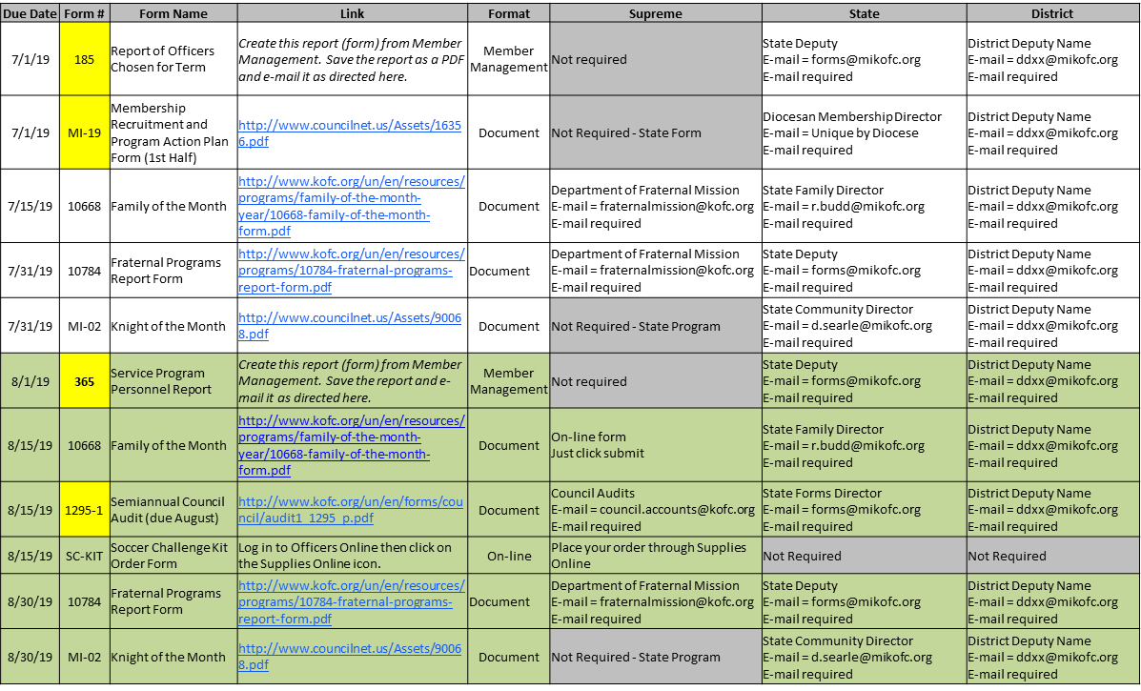
Council Forms Council Forms Directory
Process
Go to State website
Download the tracking spreadsheet
Add District Deputy e-mail address
Remove forms you don’t need
Track forms monthly (Officers mtg)

Slide 17
Critical Forms
Instructions
#185 - Report of Officers Chosen for Term - PDF - Online - due 6/30
#365 - Service Program Personnel Report - PDF - Online - due 8/1
#1295 - Semiannual Council Audit - due February 2/15
#1295 - Semiannual Council Audit - due August 9/15
#1728 - Annual Survey of Fraternal Activity - PDF - Online - due 1/31
#SP-7 - Columbian Award - PDF - Online - Instructions - due 6/30
#10784 - Fraternal Programs Report Form Enter Online
#10784 - Special Olympics - Report Form Enter Online

Slide 18
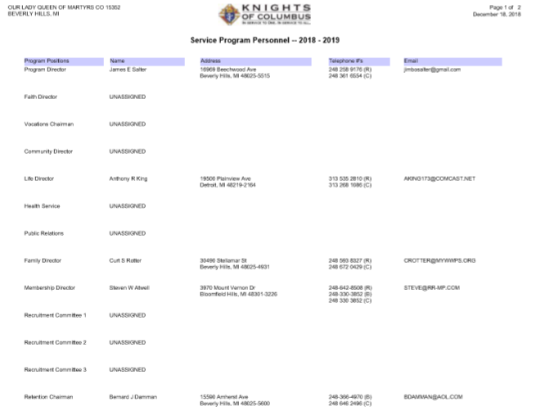
Form #185 – Report of Officers Chosen
This form is filed each Year in June
Preference is to submit through Member Management.
PDF form is available for Councils who don’t use Member Management. PDF Forms take up to 8 weeks
See Council Officer Duties for an explanation of each officer’s duties
All positions are elected except:
Chaplin is appointed
Lecturer is appointed
Financial Secretary is appointed by Supreme (recommended by GK)

Slide 19
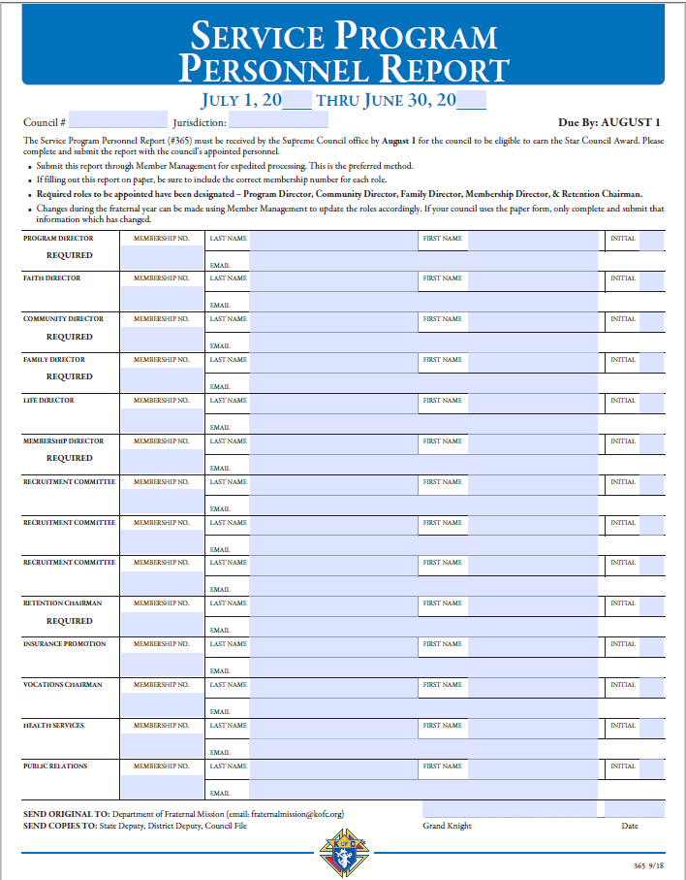
Form #365 – Service Program Personnel
This form is filed each Year in July. Amend at anytime.
Preference is to submit through Member Management.
PDF form is available for Councils who don’t use Member Management. PDF Forms take up to 8 weeks
See Council Program Personnel Duties for explanation of each Director
5 Positions are “Required”:
Program Director 4. Membership Director
Community Director 5. Retention Director
Family Director

Slide 20
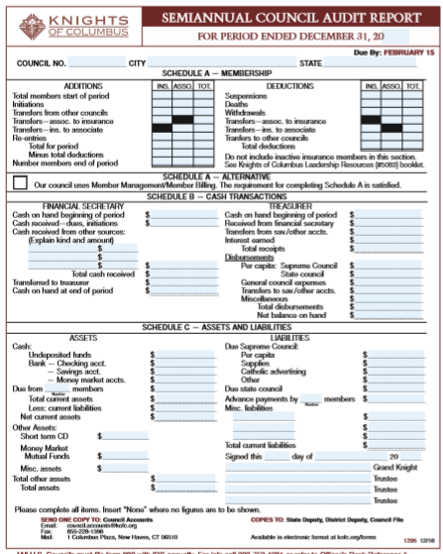
Form #1295 – Council Audit
This form should be filled out by the council Trustees with input from the Treasurer and Financial Secretary.
It’s due twice each year.
2/15 – For previous July-December
8/15 – For previous January – June
Watch the Financial Officer Training Video for a detailed walkthrough on how to fill out this form.

Slide 21
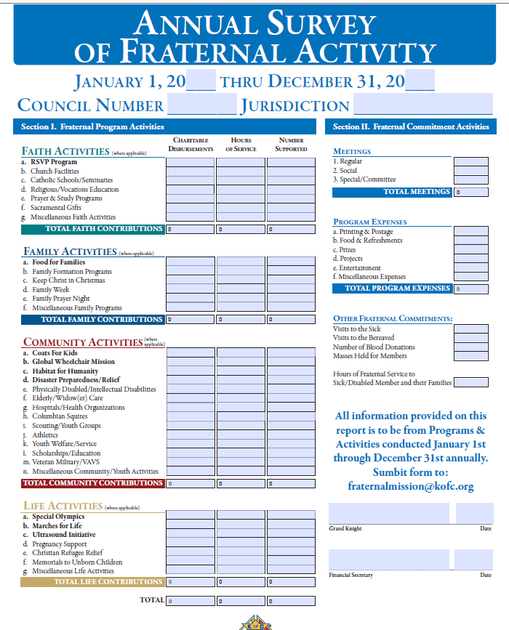
Form # 1728 - Annual Survey of Fraternal Activity
PDF Form Online form
This form should be submitted in January
It covers January – December.
Left side… Is a summary of all Programs for the year (Add up all 10784’s) + 1728A’s
Right side… Non-program information
Meetings – GK should know
Expenses – FS should know
Other – PD should know
Instructions are on page 2 of the form

Slide 22
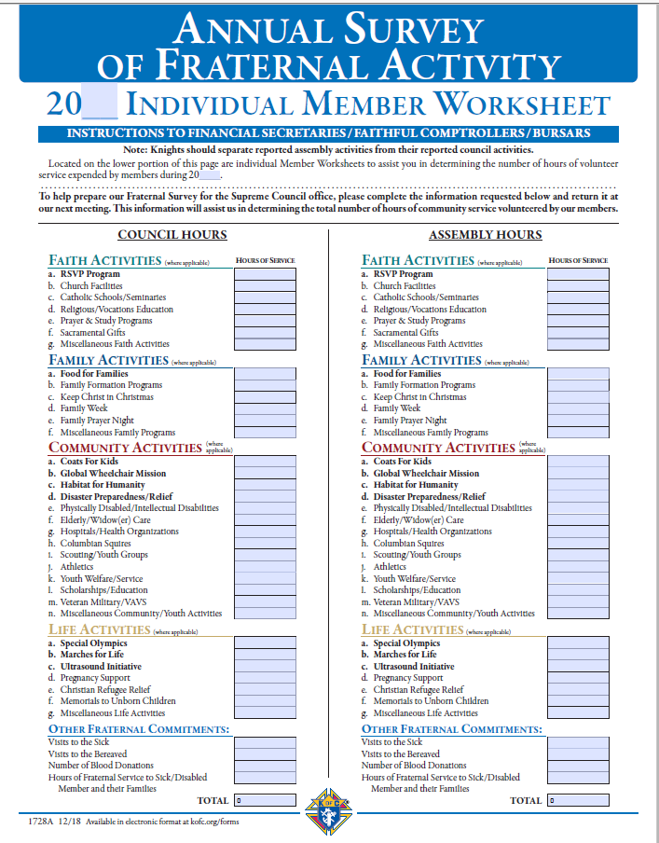
Form # 1728A - Annual Survey of Fraternal Activity Individual Member Worksheet
PDF Form
This form should be filled out by all “very active” members. But ask ALL members to fill it out.
It covers January – December.
Left side… for Councils
Don’t double count but ensure hours are covered in 1278
GK’s, DDs, & State Directors hours should be included as well.

Slide 23
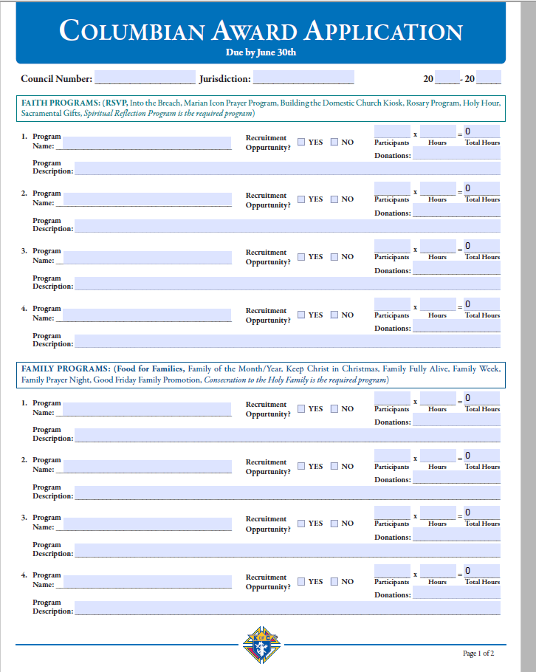
Form #SP-7 Columbian Award Application
PDF Online Instructions
This form needs to be filled out & submitted annually - Target May, Due June 30th
Fill it out & submit it whether you meet the Columbian Award criteria or not.
It’s a great record of annual accomplishments
It’s a starting point for future year council goals
It’s great information for Grand Knights & District Deputies

Slide 24
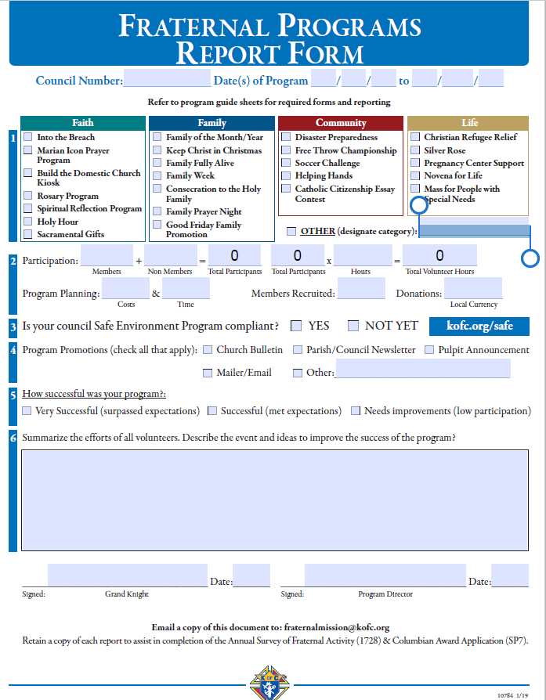
Form #SP-7 is a summary of all 10784s
Copy data from each 10784 to 1 line in the SP-7
Fill all 4 programs in each category unless you have Featured programs.
Featured programs count as 2.

Slide 25
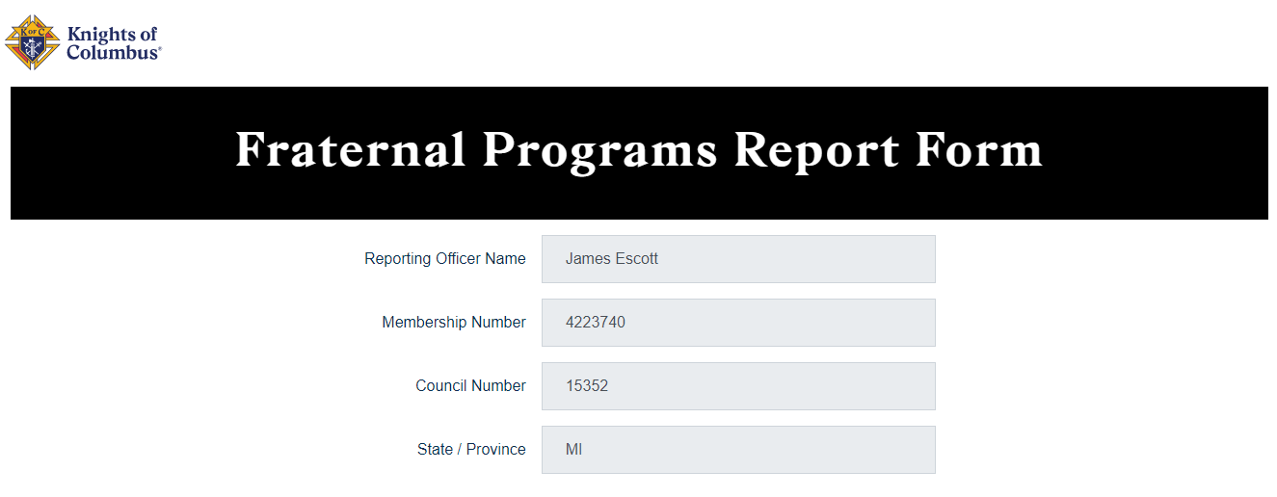
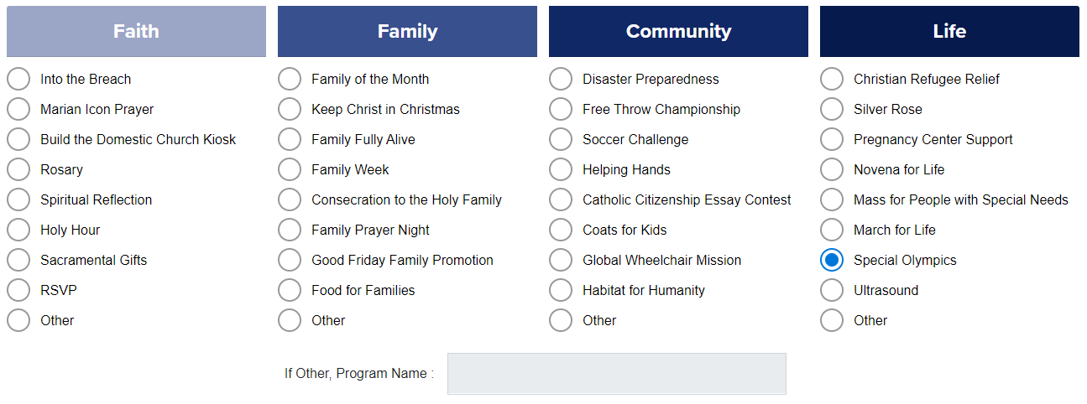
Form # 10784 – Fraternal Programs Report
Online form
This form should be submitted for each program your council does. Submit the monthly.
All Programs should include at least 10% of your council. Combine several programs to reach the 10% requirement.
These are great reference material for…
SP-7 Columbian Award
1728 – Annual Survey of Fraternal Activity
Planning & reporting for next year

Slide 26
Form # 10784 – Special Olympics Report
Online Form Instructional Video
This form is due 1/31 for the previous January - December
Please include:
Any/all council participation in Special Olympics
Any/all hours (and 20% of the dollars) spent on the Tootsie Roll Drive (MI Drive)
The 20% of the funds provided to the State goes to Special Olympics each year.

Slide 27
District Deputy
District Forms

